Slide 1
CPSC3300: Computer Systems Organization
Lecture 4 – Benchmarking

Slide 2
Overview
Pitfalls in performance evaluation
Power
Benchmarking
Benchmarks
Results analysis

Slide 3
Performance Summary
IC
CPI
Cycle time T_{c}
Performance depends on
Algorithm: affects ?
Programming language: affects ?
Compiler: affects ?
Instruction set architecture: affects ?
What is IPC?
What is good for your program,
a IPC high or low?
IC, possibly CPI
IC, CPI
IC, CPI
IC, CPI, T_{c}

Slide 4
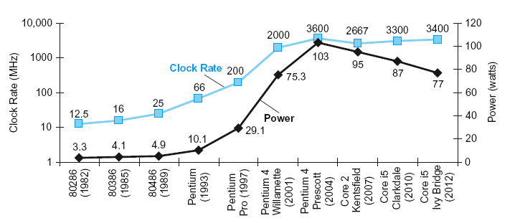
Power Trends
The Power Wall
In CMOS IC technology
×30
5V → 1V
×1000

Slide 5
Reducing Power
Suppose a new CPU has
85% of capacitive load of old CPU
15% voltage and 15% frequency reduction
The power wall
We can’t reduce voltage further
We can’t remove more heat
How else can we improve performance?

Slide 6
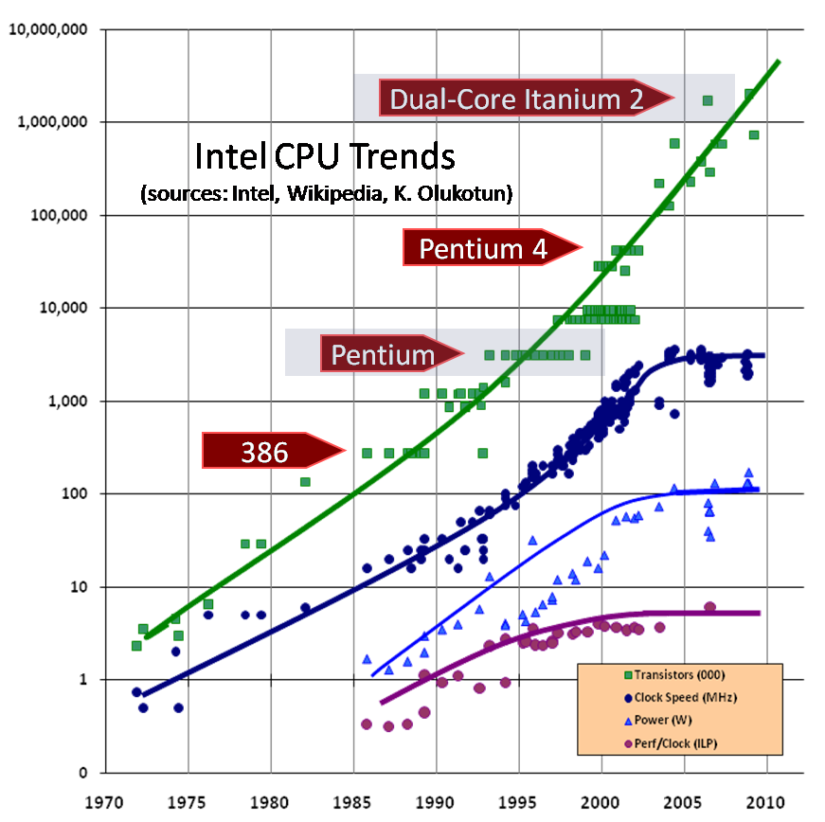
Free Lunch Is Over

Slide 7
Parallel System Are Ubiquitous Today
CMP (Chip Multiprocessing) with multiple cores
Used in high end in servers to low power in mobiles systems
High end server processors Xeon and Opteron
Quad-core, six-core, 10-core processors
Atom processors in netbooks
Dual-core, quad-core, six-core
Processors in cell phones
Dual-core, quad-core, six-core

Slide 8
Benchmarking
Some definitions are:
It is a test that measures the performance of a system or subsystem on a well-defined task or set of task.
A method of comparing the performance of different computer architecture.
Or a method of comparing the performance of different software
Benchmarks usually report performance data

Slide 9
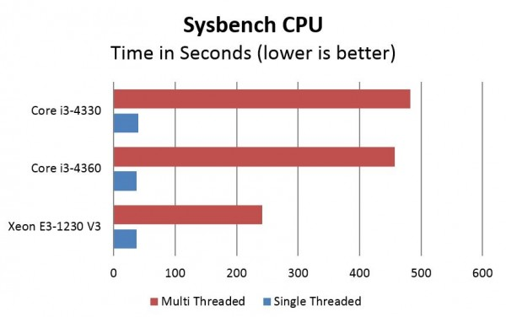
Benchmarking Results Example
Compare three architectures
Core i3-4330
Core i3-4360
Xeon E3-1230 V3

Slide 10
Types of Benchmarks
Real programs.
have input, output, and options for running the program
E.g.: Compilers, text processing software, etc.
Kernels: small, key pieces from real programs.
E.g.: Livermore Loops and Linpack
Toy benchmarks: typically between 10-100 lines of code
Produce a result the user already knows
E.g.: Sieve of Eratosthenes, Puzzle, and Quicksort
Synthetic benchmarks: to match an avg exec. profile
Examples: Whetstone and Dhrystone.

Slide 11
Benchmarking
Methods
Real programs
Modified apps (cint2000, cfp2000 of SPEC)
Kernels
Livermore Kernels, LinPACK
Toy Benchmarks
Sieve of Eratosthenes (highest common factor), quicksort
Synthetic Benchmarks
Whetstone, Dhrystone
Problems with benchmarking?
accuracy

Slide 12
Benchmarking Pitfalls
Optimization option on today’s compilers can affect the results of benchmark tests
Modification of the sources (public-domain software) produces different versions of the benchmark
Many benchmarks test only one aspect of a system
Different aspects to test are: CPU, I/O, File System, etc.
A compiler can “recognize” a benchmark suite and loads a hand-optimized algorithms for the test
Problem
Benchmarks drive vendors to improve benchmarks

Slide 13
Benchmark Suites
Benchmark suites
A collection of benchmarks measuring the performance of systems/subsystems with a variety of applications.
Weakness of any one benchmark is lessened by the presence of the other benchmarks.
Some benchmarks are kernels, but many are real programs.
Examples
SPEC (spec.org): cpu, cloud, storage, power…
HPL (http://www.netlib.org/benchmark/hpl/): computer cluster
Problem
How do we compare using a suite of applications

Slide 14
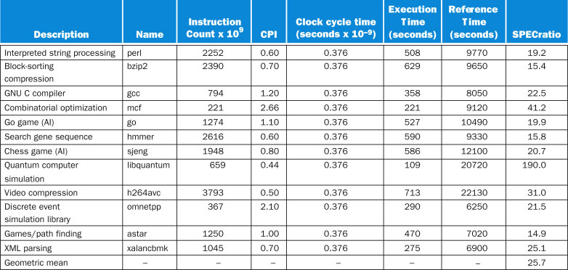
SPEC Benchmarks Results
SPECINTC2006 benchmarks running on a 2.66 GHz Intel Core i7 920.

Slide 15
Lies, darn lies, and statistics
C2 is 10x faster than C1 for Prog A
C1 is 10x faster than C2 for Prog B
C3 is 10x faster than C2 for Prog A
C3 is 1.5x faster than C2 for Prog B
To minimize
Cheating on results
Apples to oranges
Define methods for comparisons of workloads (benchmarks)
How to fairly compare multiple machines and codes
Using total execution time
C1 is 2.4x faster than C2
C1 is 1.5x faster than C3
C3 is 1.5x faster than C2
 | Computer 1 | Computer 2 | Computer 3
Program A | 100 | 10 | 1
Program B | 30 | 300 | 200
Total | 130 | 310 | 201
All quantifiable methods should be proportional to total execution time – the great comparator – ensuring reflection of real performance.

Slide 16
Let’s get mean
Arithmetic mean
Arithmetic mean (weighted)
Computer 1
Computer 2
Computer 3
Program A
100
10
1
Program B
30
300
200
Total
130
310
201
What about unequal emphasis of codes in suite?
*Both track total execution time

Slide 17
Weighted arithmetic mean example
Arithmetic mean (weighted)
 | Comp A | Comp B | Comp C
Prog 1 | 1 | 10 | 20
Prog 2 | 1000 | 100 | 20
 | W₁=.5, W₂=.5 | W₁=.909,W₂=.091 | W₁=.999,W₂=.001
Computer A | 500.5 | 91.909 | 1.999
Computer B | 55 | 18.10 | 10.09
Computer C | 20 | 20 | 20

Slide 18
Be normal
Normalized execution time: normalize to a particular machine by dividing all execution times by chosen machine’s time
Example: Program P1 has the following execution times:
On machine A: 10 secs
On machine B: 100 secs
On machine C: 150 secs
Normalized to A: A=1, B=10, C=15
Normalized to B: A=.1, B=1, C=1.5
Execution time ratio

Slide 19
Getting Meaner
Taking the average of the normalized times
Normalized arithmetic mean
Normalized geometric mean
 | Comp A | Comp B | Comp C
Prog 1 | 1 | 10 | 20
Prog 2 | 1000 | 100 | 20

Slide 20
Normalized example
 | Normalized to A |  |  | Normalized to B |  |  | Normalized to C
 | A | B | C | A | B | C | A | B | C
ETR P1 | 1 | 10 | 20 | .1 | 1 | 2 | .05 | .5 | 1
ETR P2 | 1 | .1 | .02 | 10 | 1 | .2 | 50 | 5 | 1
 | Normalized to A |  |  | Normalized to B |  |  | Normalized to C
 | A | B | C | A | B | C | A | B | C
NAM | 1 | 5.05 | 10.01 | 5.05 | 1 | 1.1 | 25.0 | 2.75 | 1
NGM | 1 | 1 | .63 | 1 | 1 | .63 | 1.58 | 1.58 | 1
Bad idea

Slide 21
Geometric vs. Arithmetic
Arithmetic mean
Provides weighted average
Pros: proportional to overall execution time
Cons:
Can be rigged easily (disproportionate problem size)
Cannot use with normalizing
Normalized Geometric mean
Provides relative performance of machines to ref
Pros: same results regardless of ref machine
Cons:
Not proportional to overall execution time
Large % change in small overall time contributor can skew
Suggestions
Weight programs according to their actual frequency
Use problem size to pre-normalize program execution time
Combine approaches: summary of simple means and relative performance to base machine

Slide 22
Supplemental Reading
SPEC benchmark website
https://www.spec.org/
High performance Linpack
http://www.netlib.org/benchmark/hpl/
High performance computing challenge
http://icl.cs.utk.edu/hpcc/
Computer benchmarking: paths and pitfalls
By Jack Dongarra et al

Slide 23
Summary
CPU time calculation
Power trend and power wall
Common benchmarks
Benchmarking results analysis
Reading for next week:
8.1-3

